Slide 1

Course Project Accident topic modeling
Student: Tishun Peng

Slide 2
Objective
Implement natural language processing and topic modeling algorithms to a practical problem
Extract informative features (n-grams) from a collection of documents
Identify the topics included in NTSB reports
Predict the topic of another report in the test dataset

Slide 3
Why is it useful?
NLP techniques can save the efforts of physically reading investigation documents, which may have hundreds of pages
Find the reports that may be relevant to a specific type of accident using the trained topic model
Programmatically extract critical information from a specific report

Slide 4
Development process
Select training and test data
Preprocess textual data
Train NMF model
Retrieve critical features
Train LDA model
Load report and predict topic
Plot 2-D topic projection
word distribution
Load report and predict topic

Slide 5
Technical details
52 accident training reports from NTSB website covering aviation, highway, marine, pipeline and railway industries
10 test reports for the above-mentioned topics
Train NMF and LDA models for topic modeling
Extract top 5 words to represent each topic and top 40 words to show word distribution
A GUI is developed to encapsulate all functionalities

Slide 6
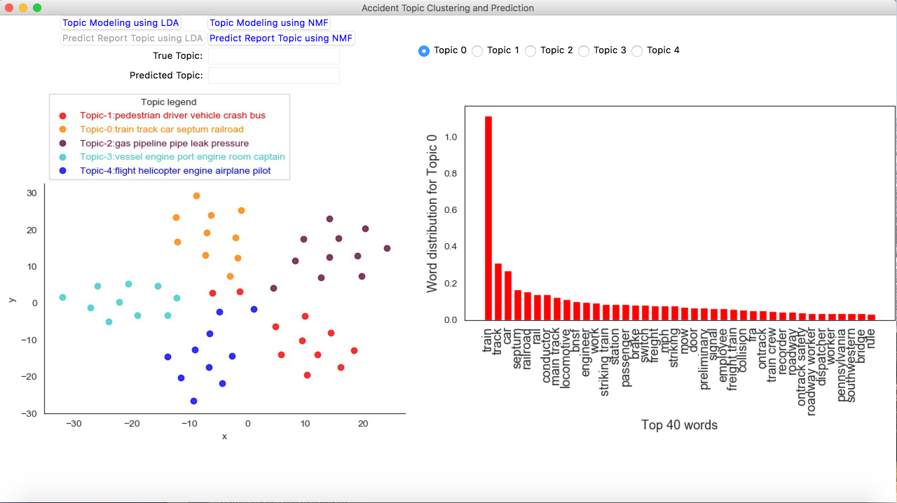
Graphical User Interface (GUI)
1. Train model
2. Select topic to show word distribution
3. Predict topic

Slide 7
Setup and Run
Download and install Python 3.7
Install required packages
matplotlib, scikit-learn, tkinter, Pillow
numpy, tika, glob, pandas, seaborn, string, regex
Clone github repository
git clone https://github.com/tspeng/Course_Project.git
Run application
cd Course_Project
python Application_code.py

Slide 8
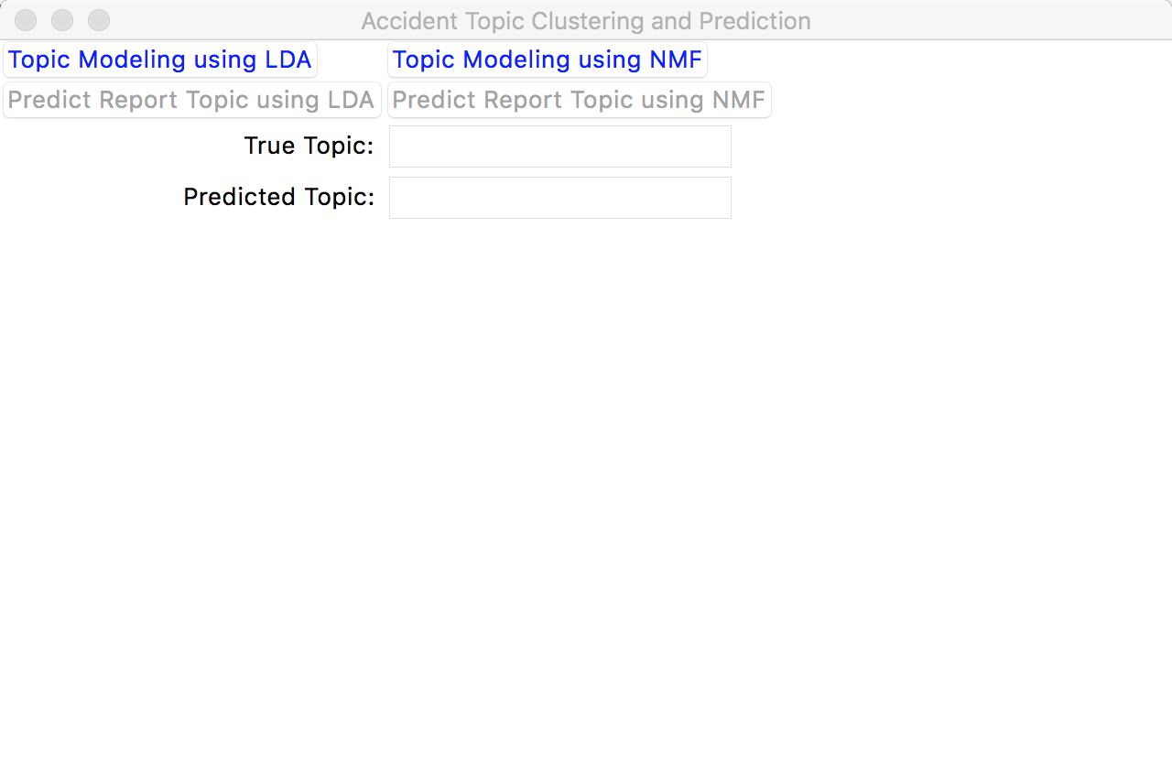

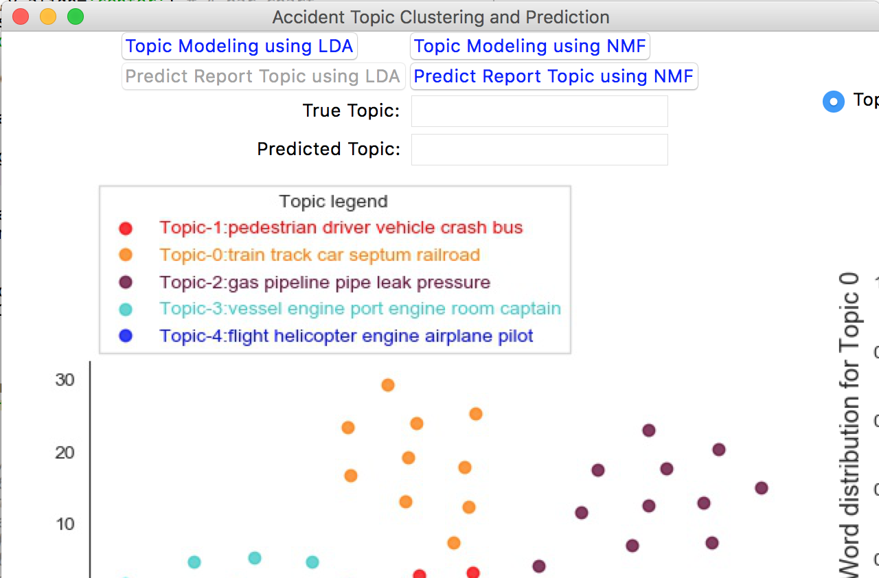
Example
1. Train topic model
2. Select topic to show word distribution

Slide 9
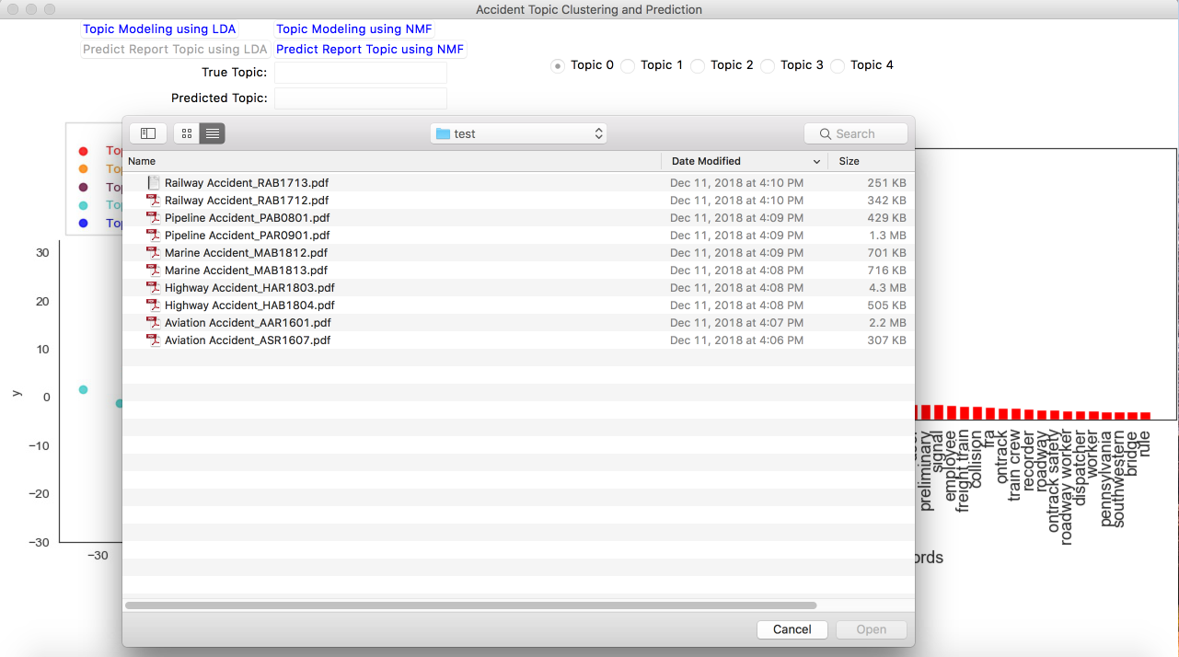
Example
3. Select document to predict topic

Slide 10
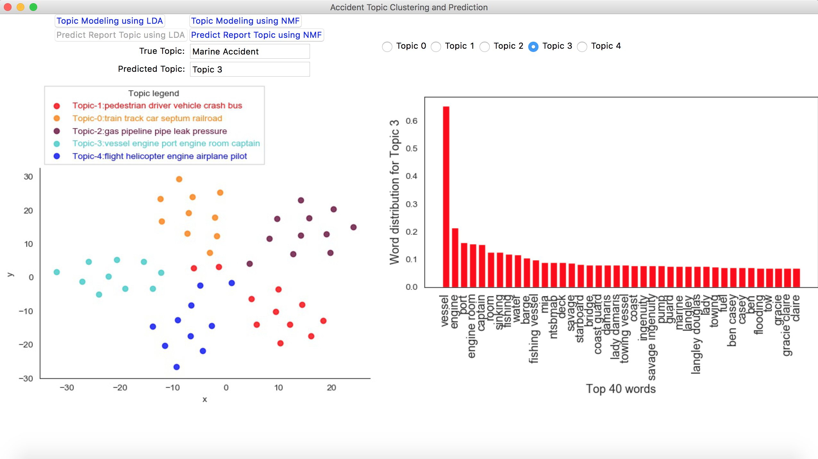
Example
Stop script: Press Ctrl + C

Slide 11
Conclusions
NMF can achieve relatively better topic modeling results than LDA
Histograms of top ranking words can clearly represent the nature of each type of accident(topic)
From the 2-D projection, intra-cluster similarity is much higher than inter-cluster similarity
The trained model can provide pretty accurate prediction for report topic

